Slide 1


Slide 2
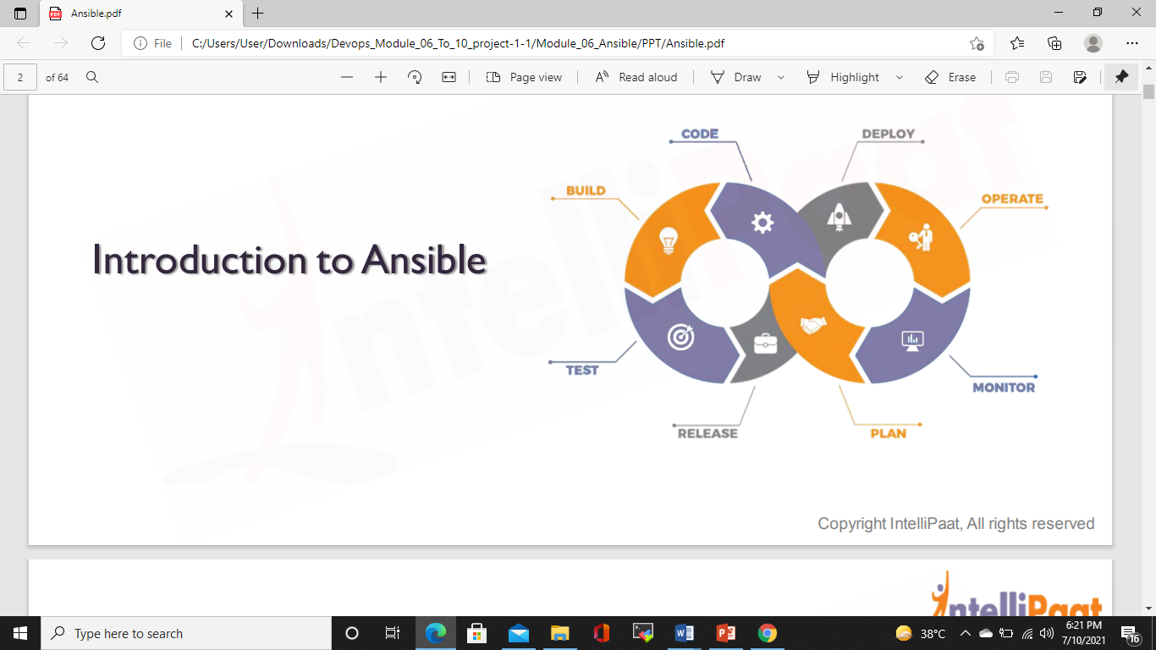

Slide 3
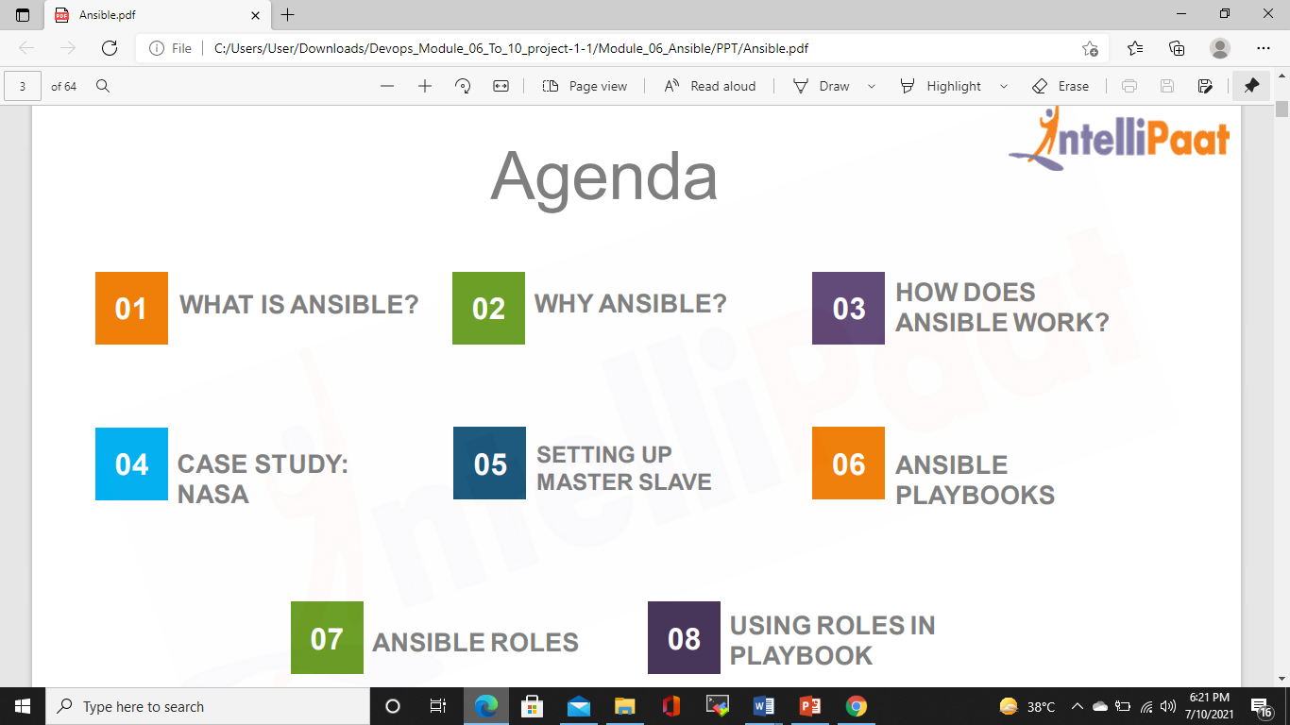
AGENDA

Slide 4
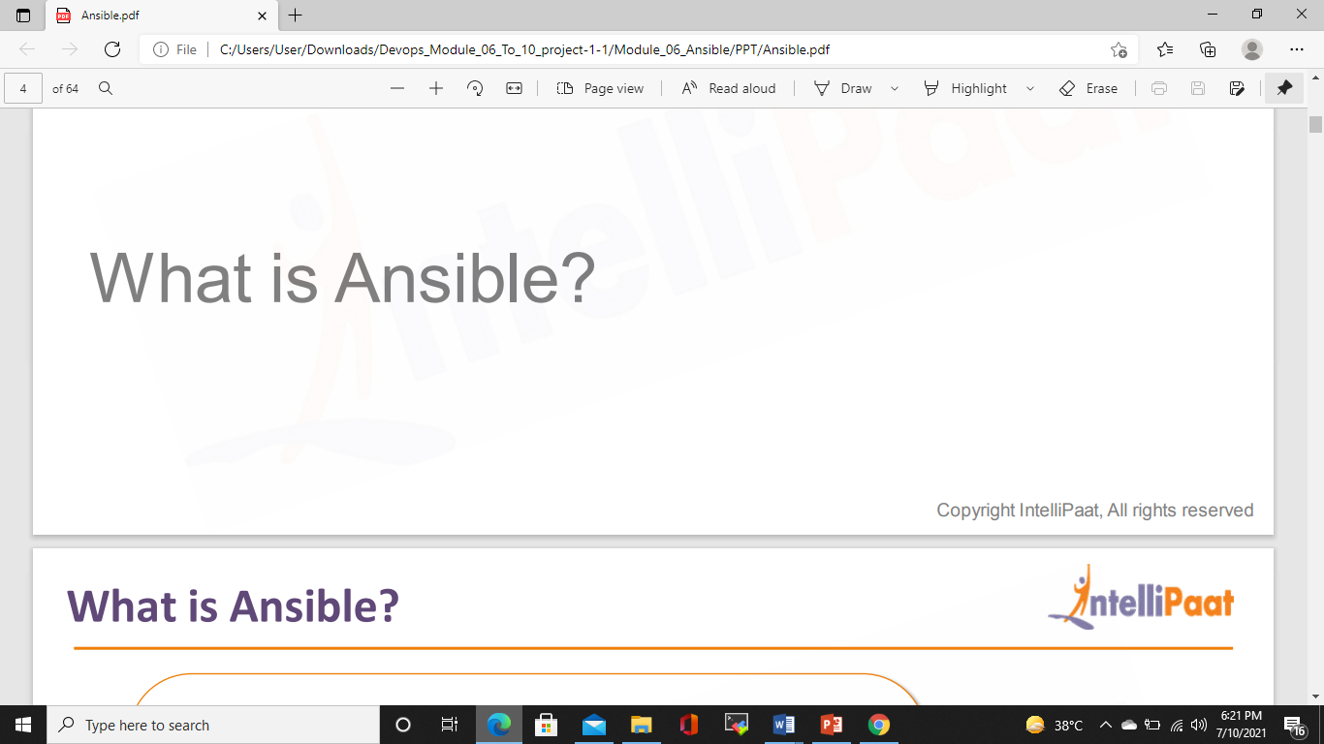

Slide 5
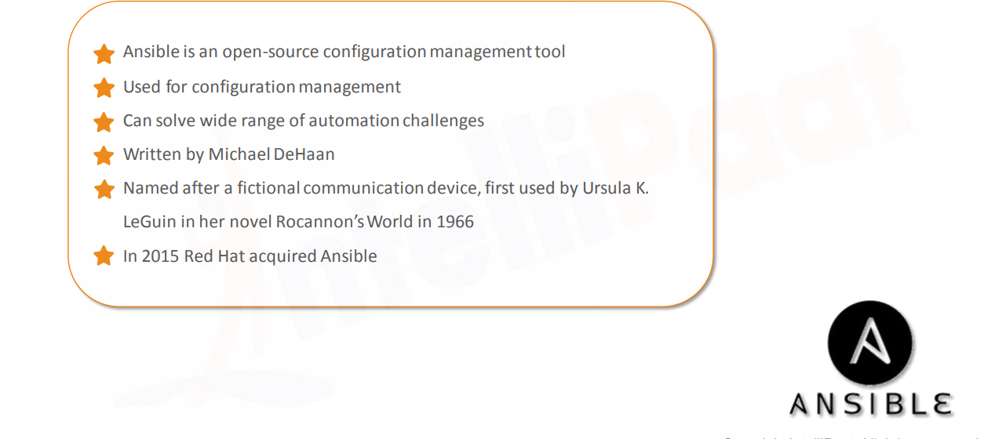
ANSIBLE

Slide 6
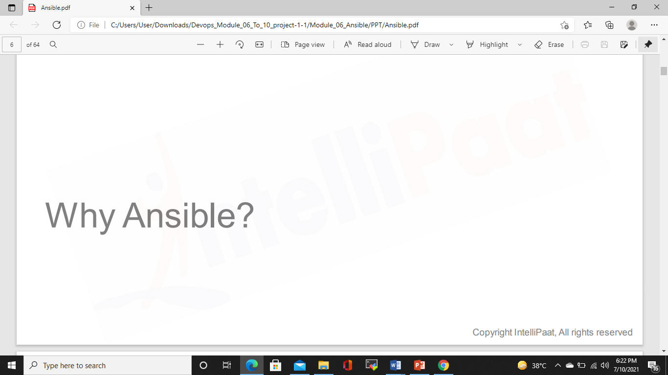

Slide 7
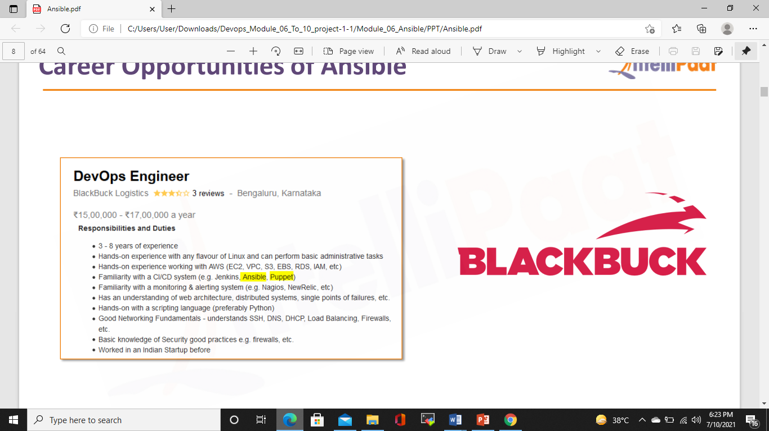
Career Opportunities of Ansible

Slide 8
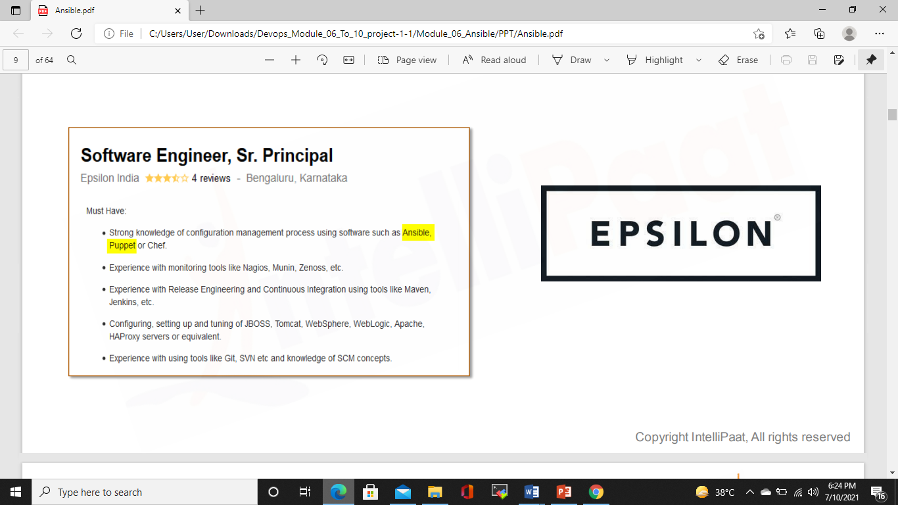
Career Opportunities of Ansible

Slide 9
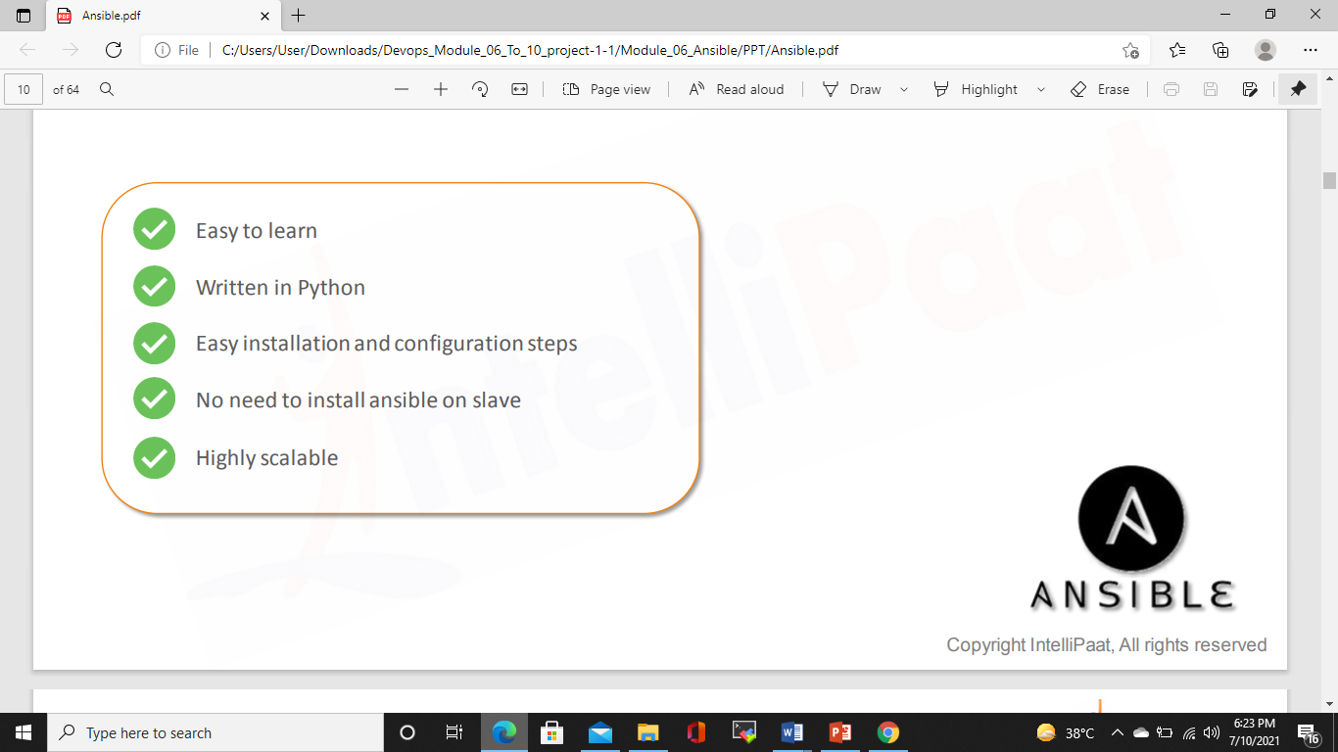
Advantages of Ansible

Slide 10
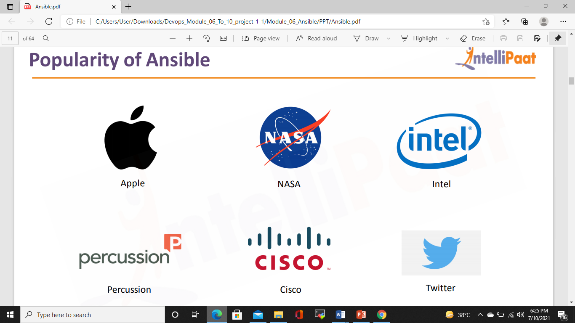
Popularity of Ansible

Slide 11
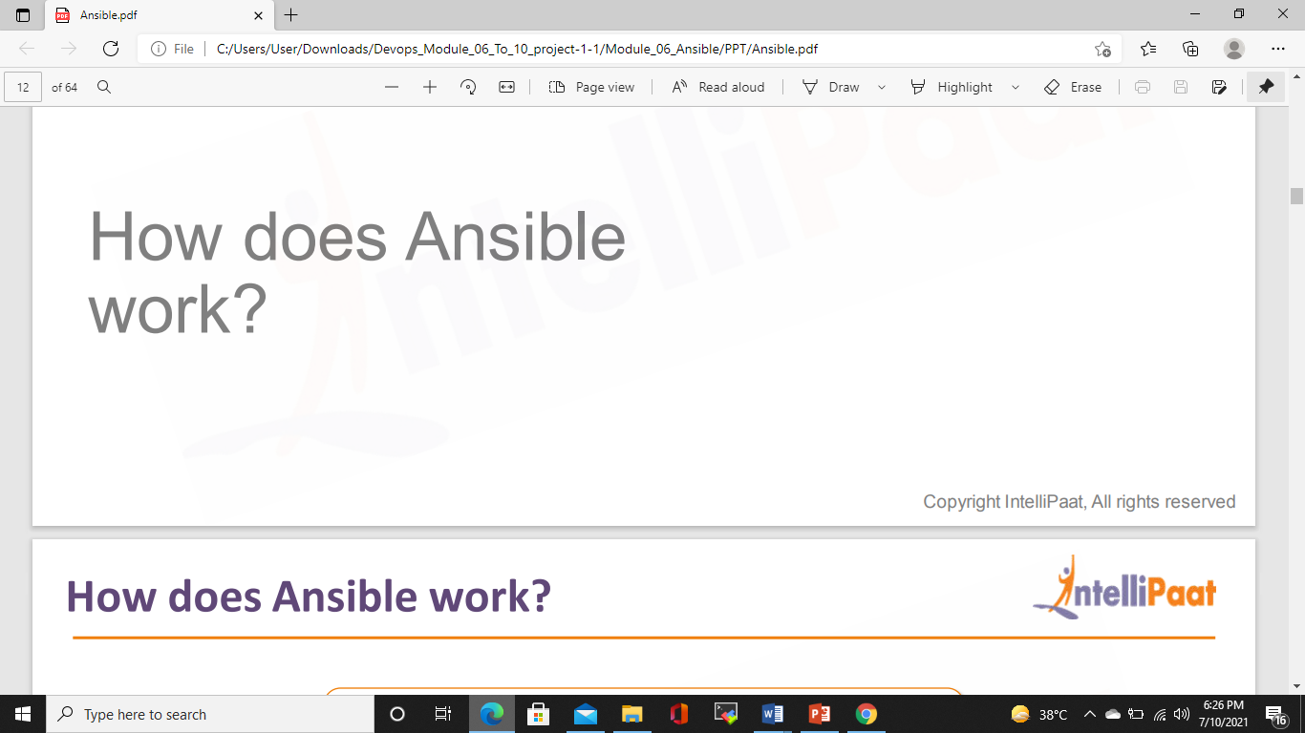

Slide 12
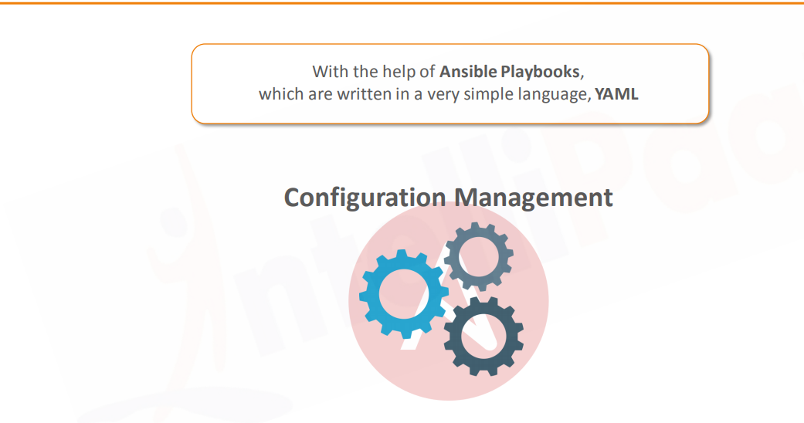
How does Ansible work?

Slide 13
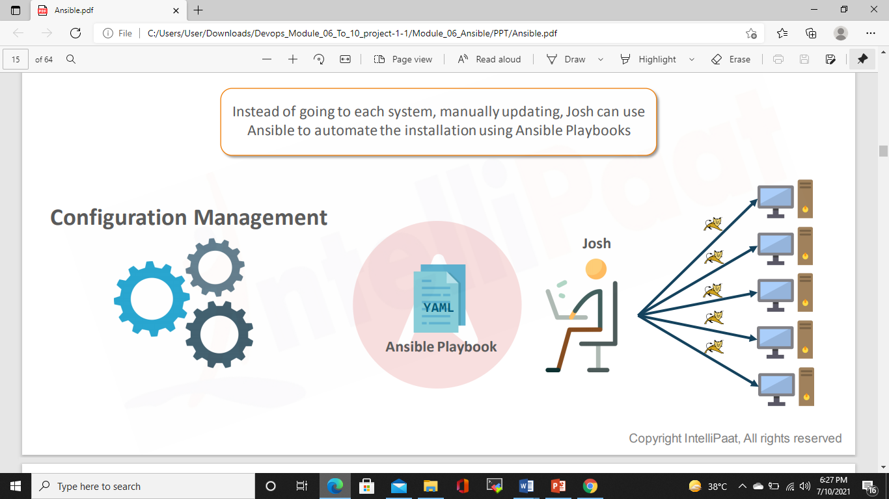
Problem Statement-Solution with Ansible

Slide 14
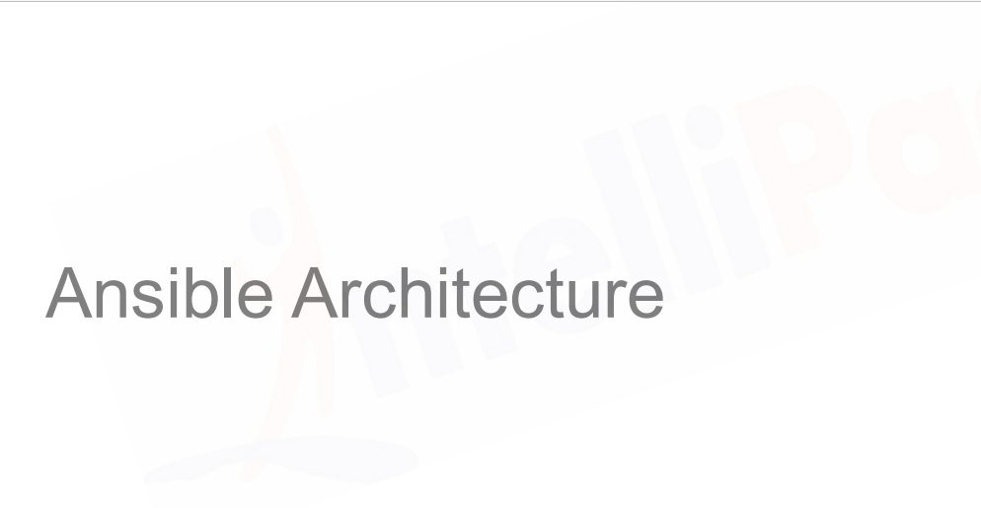

Slide 15
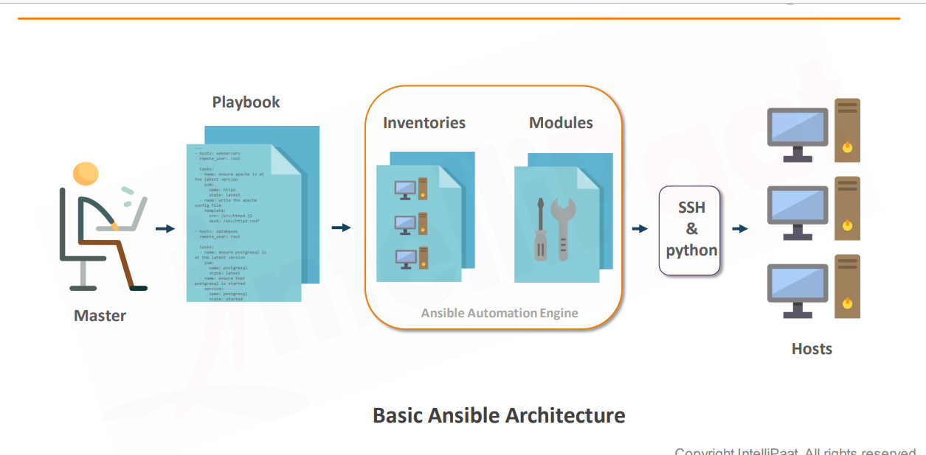
Basic Ansible Architecture

Slide 16
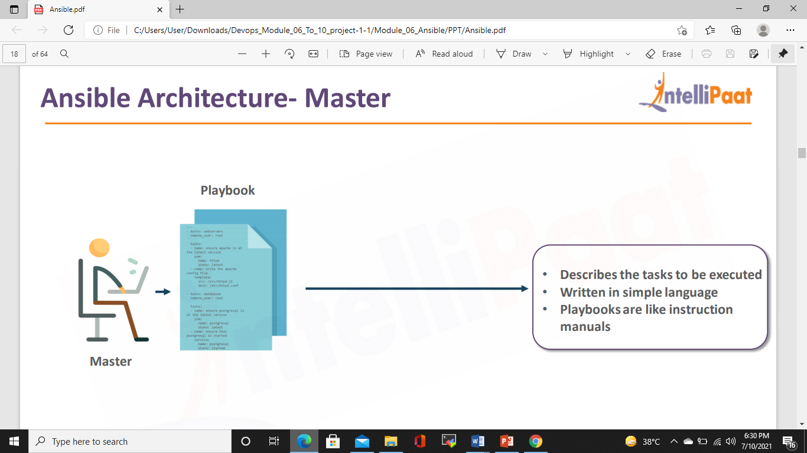
Ansible Architecture-Master

Slide 17
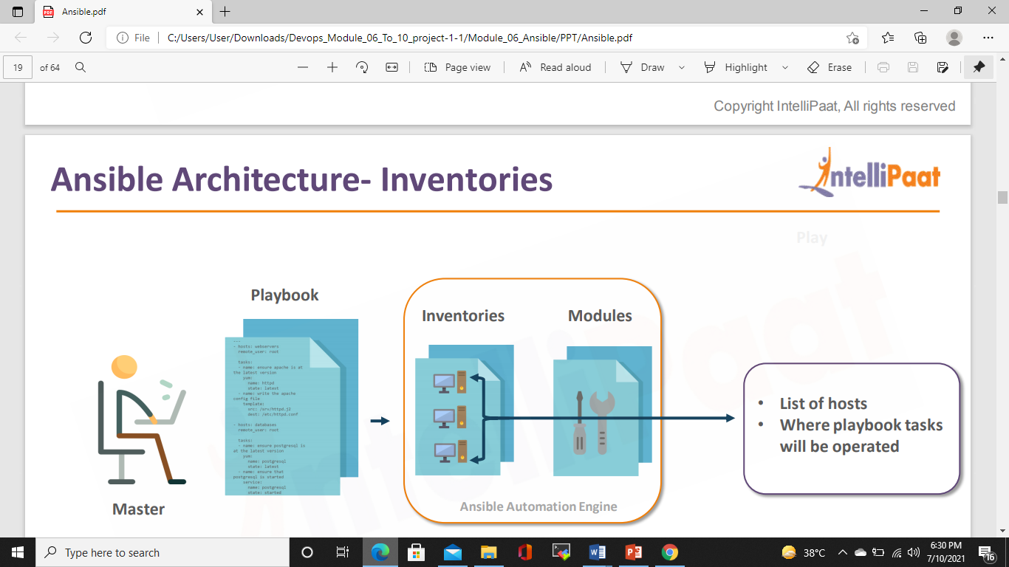
Ansible Architecture-Inventories

Slide 18
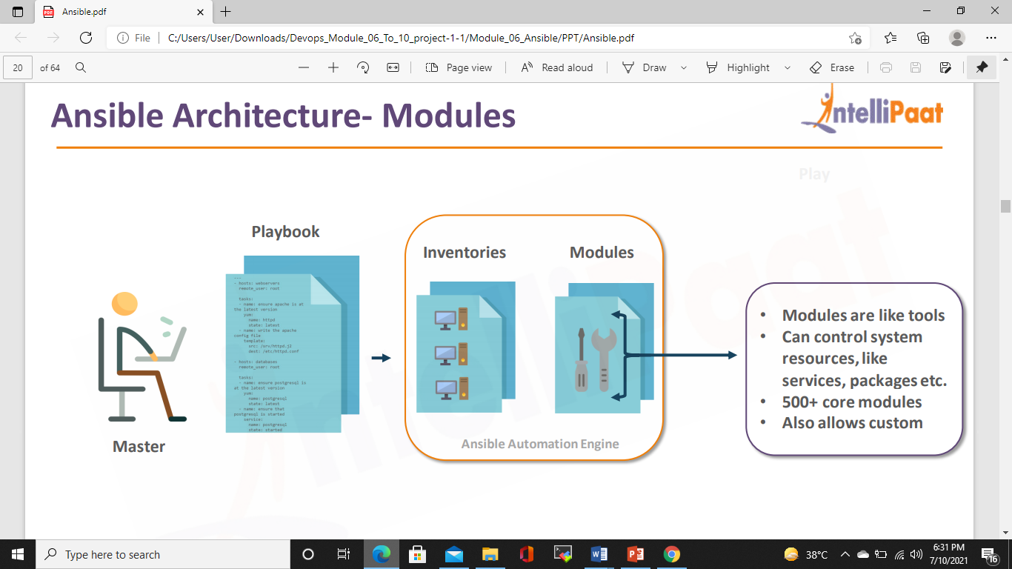
Ansible Architecture-Modules

Slide 19
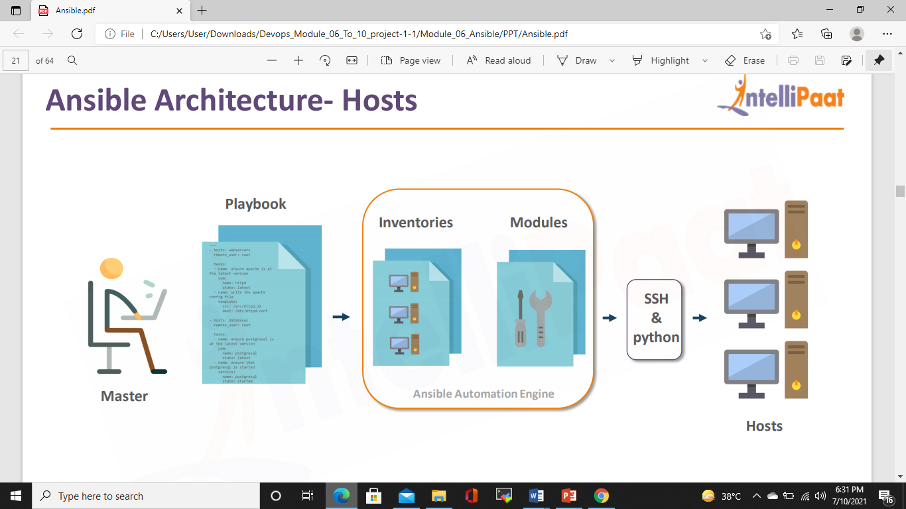
Ansible Architecture-Hosts

Slide 20
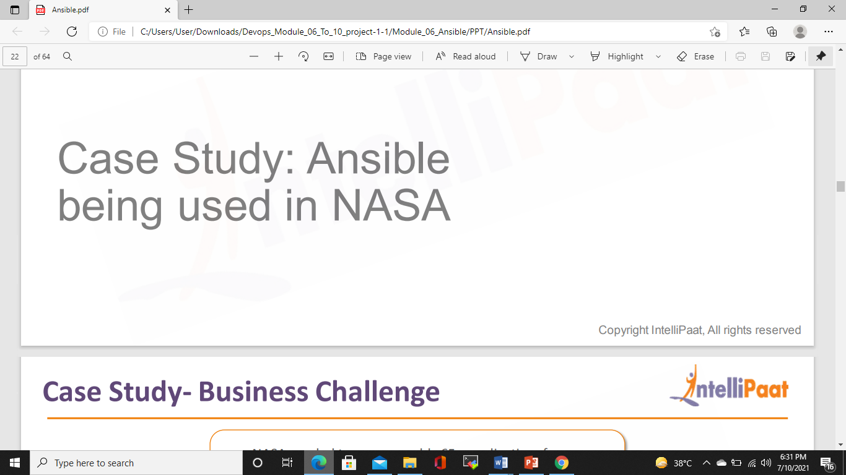

Slide 21
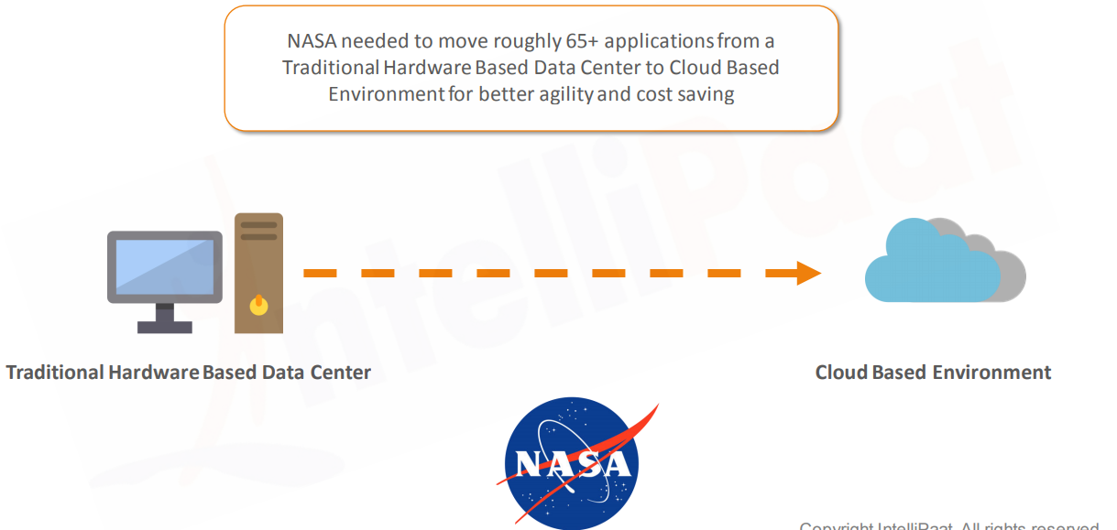
Case Study – Business Challenge

Slide 22
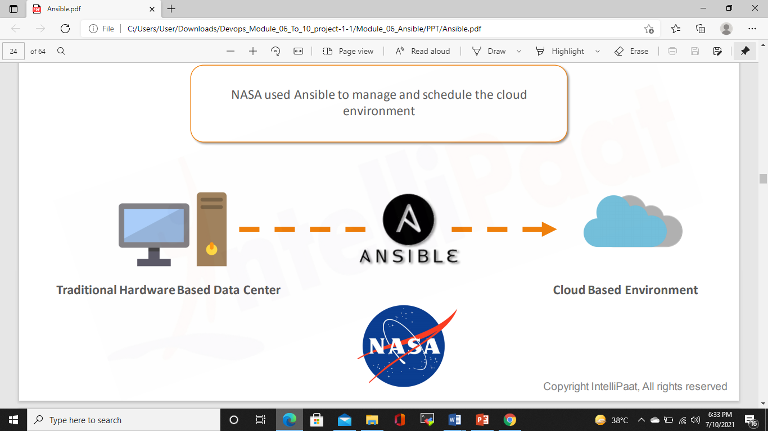
Case-Study Solution

Slide 23
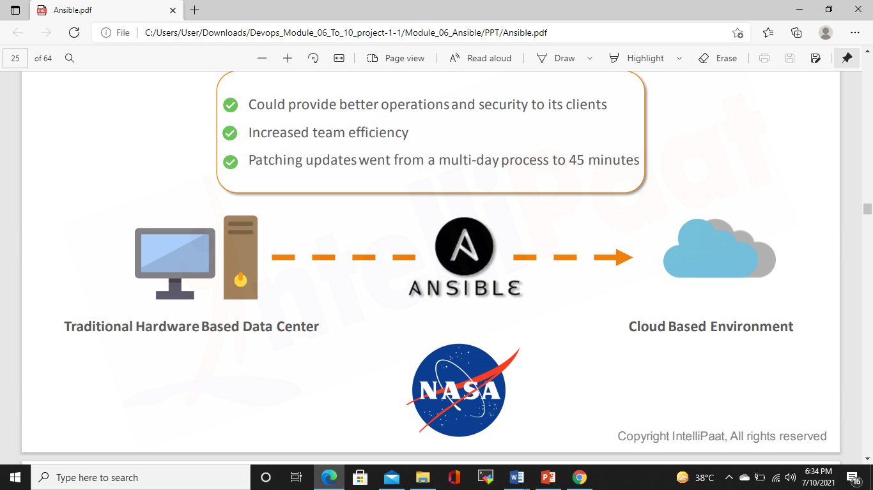
Case-Study Results

Slide 24
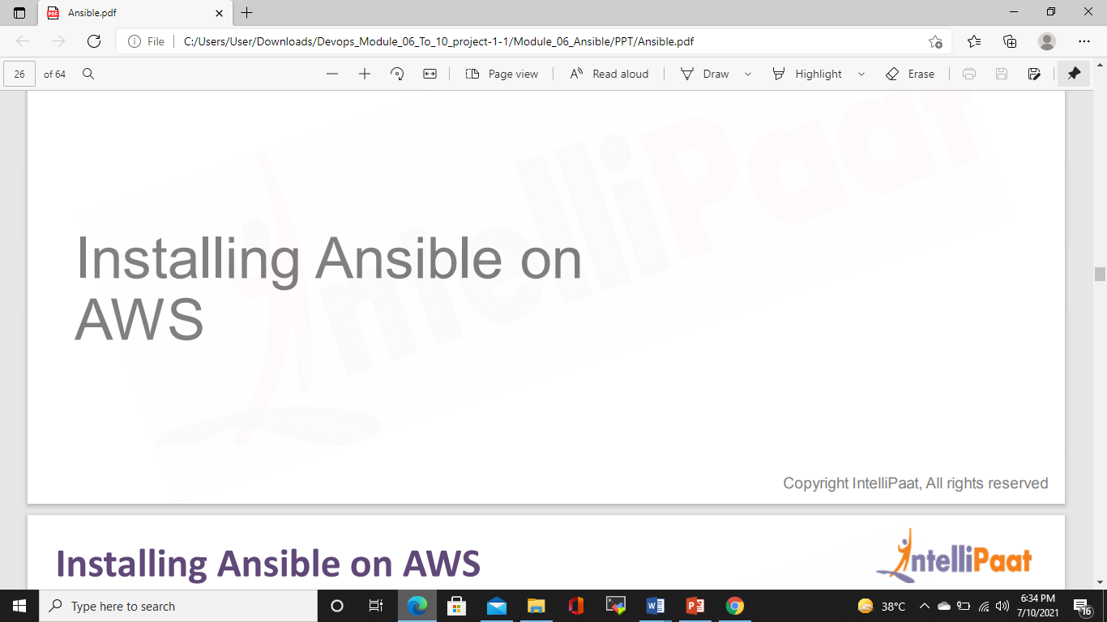

Slide 25
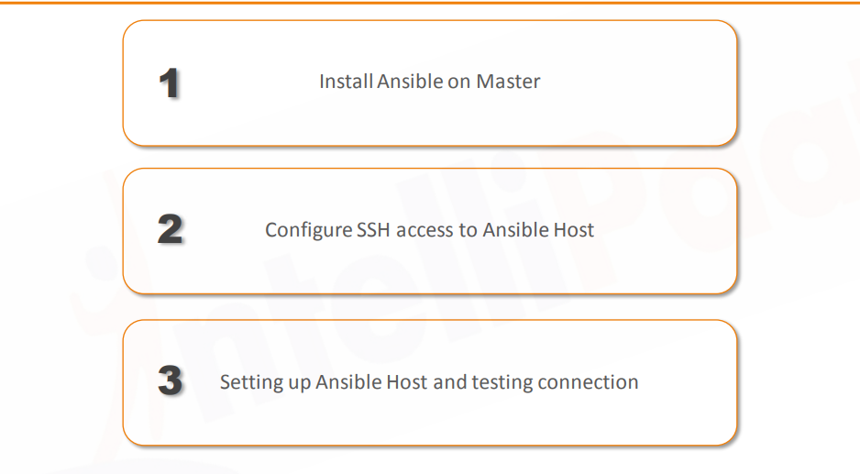
Installing Ansible on AWS

Slide 26
Installing Ansible on AWS
On Master Machine
sudo apt update
sudo apt install software-properties-common
sudo add-apt-repository --yes --update ppa:ansible/ansible
sudo apt install ansible

Slide 27
On Ansible Controller Machine
ssh-keygen -t rsa -b 4096 -C "Ansible controller"
cat /home/ubuntu/.ssh/id_rsa.pub
Copy the Content and login to target Machine
On Target Machine
vi .ssh/authorized_keys
Paste the contents and save
Now From Ansible Controller Machine do ssh
ssh ubuntu@54.153.83.74

Slide 28
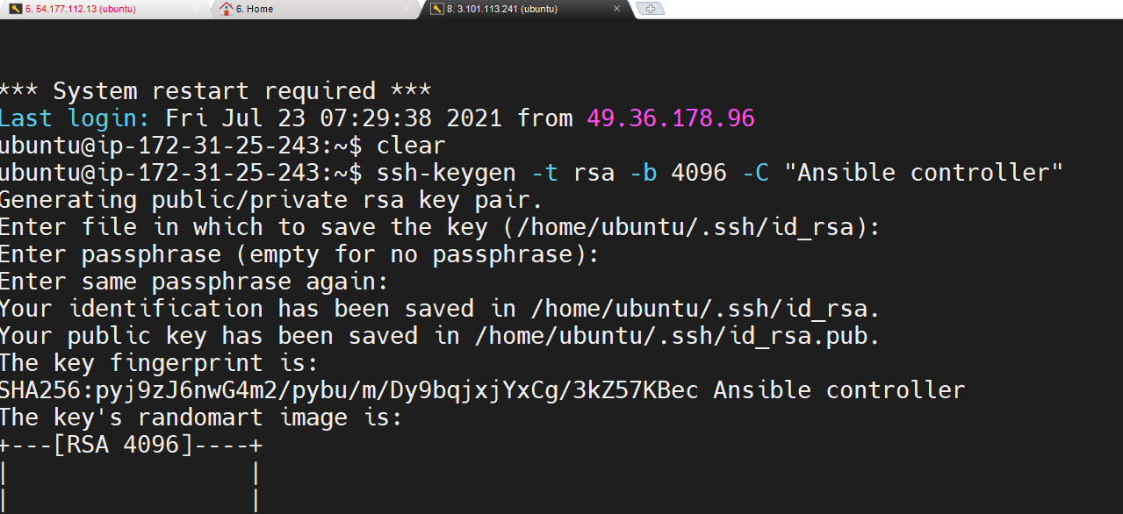
On Ansible Controller Machine

Slide 29
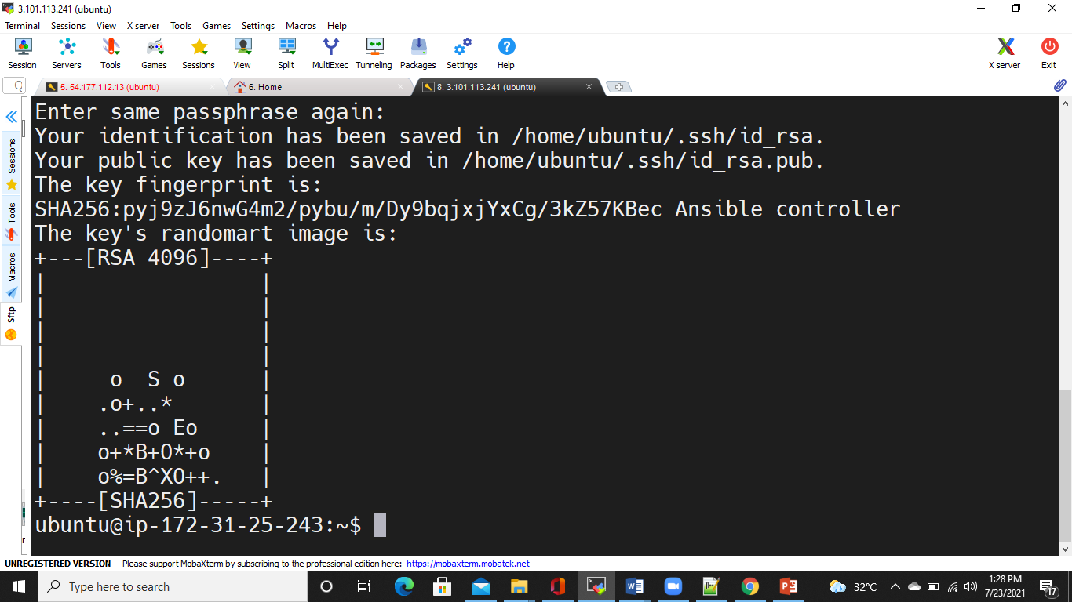
On Ansible Controller Machine

Slide 30
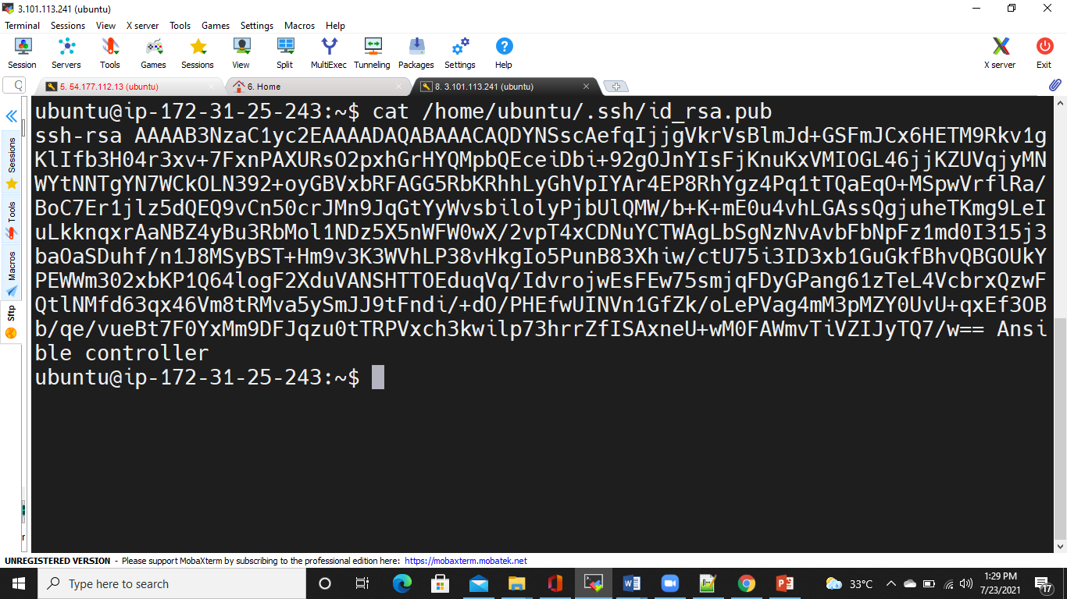
On Ansible Controller Machine

Slide 31
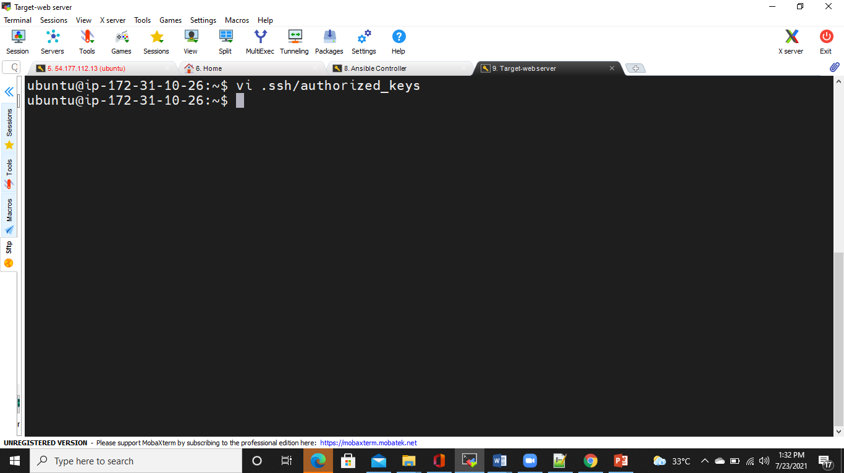
On Target Machine

Slide 32
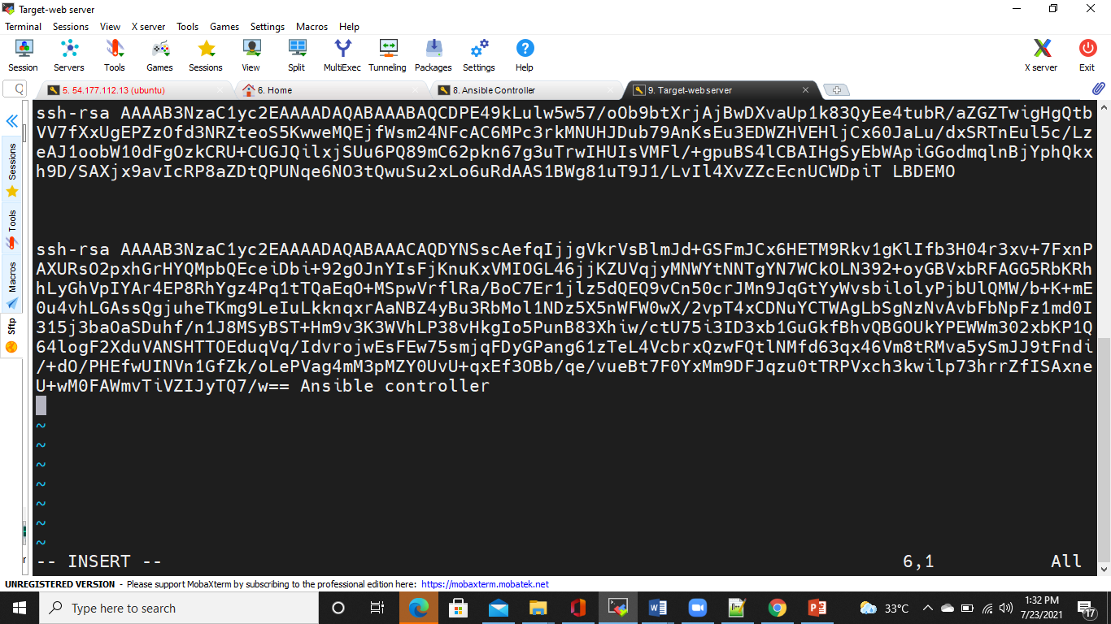
On Target Machine

Slide 33
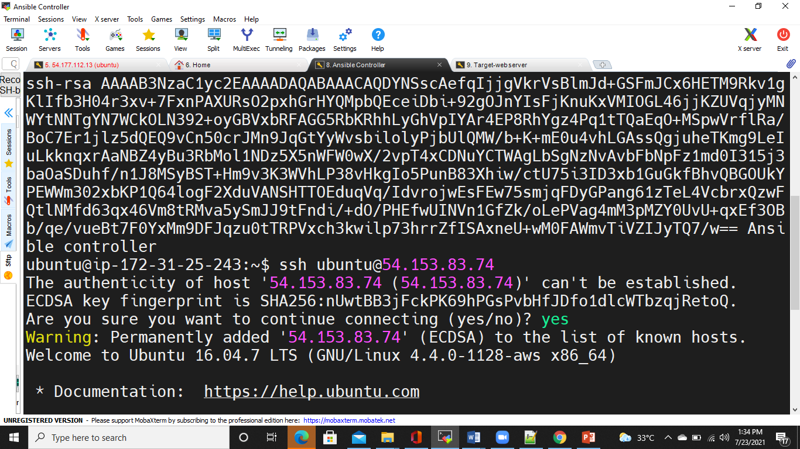
On Ansible Controller Machine

Slide 34
Making of Host file
Default location is /etc/ansible/hosts
Now you can make host file in your workspace also
Create directory : ansible-ws
In this directory create one file vi hosts

Slide 35
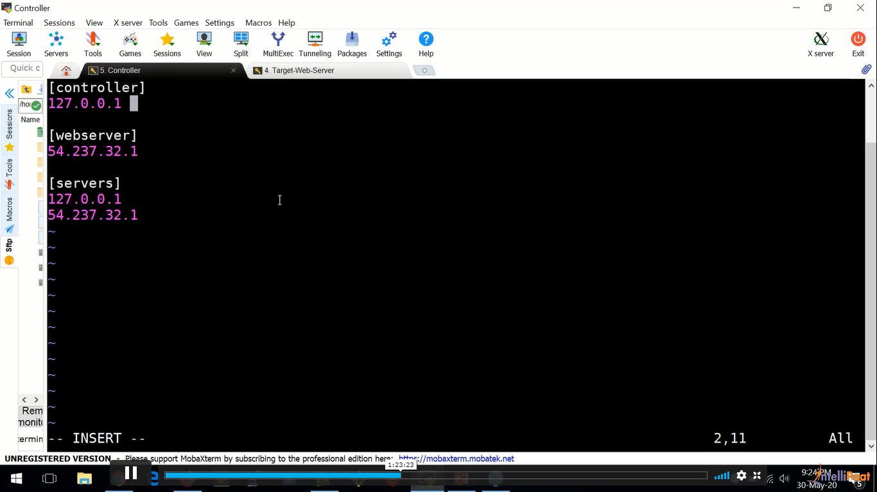
Entry in Hosts file

Slide 36
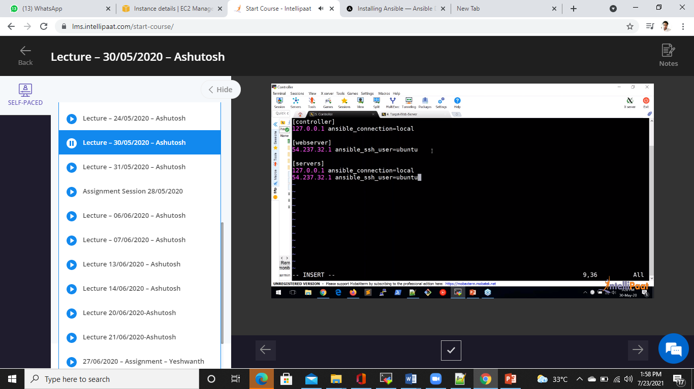
Entry in Hosts file

Slide 37
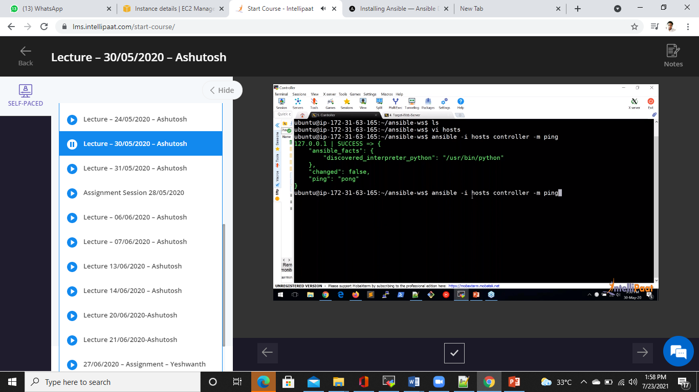
Connection checkup : Controller

Slide 38
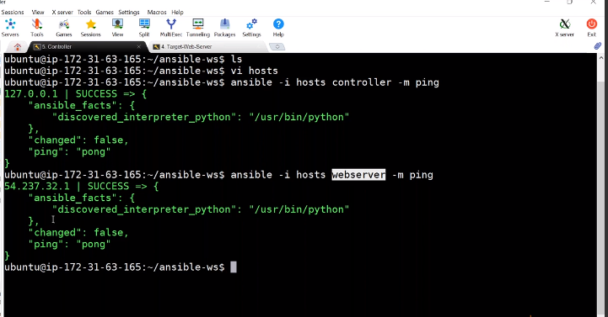
Connection checkup :webserver

Slide 39

Connection checkup : servers

Slide 40
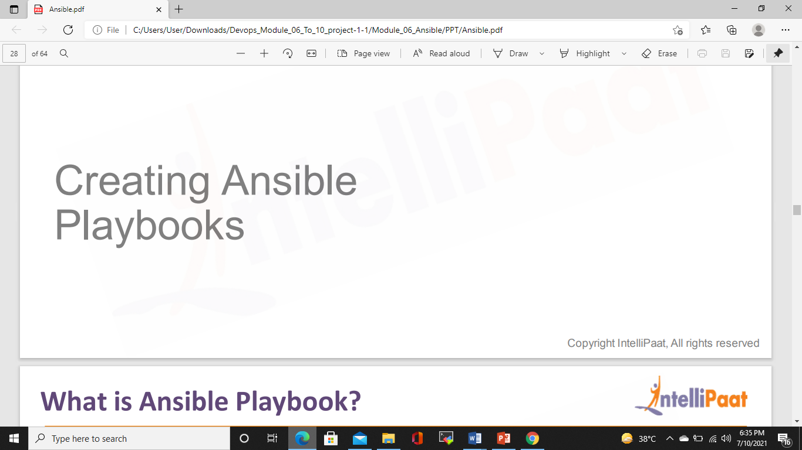
Creating Ansible Playbooks

Slide 41
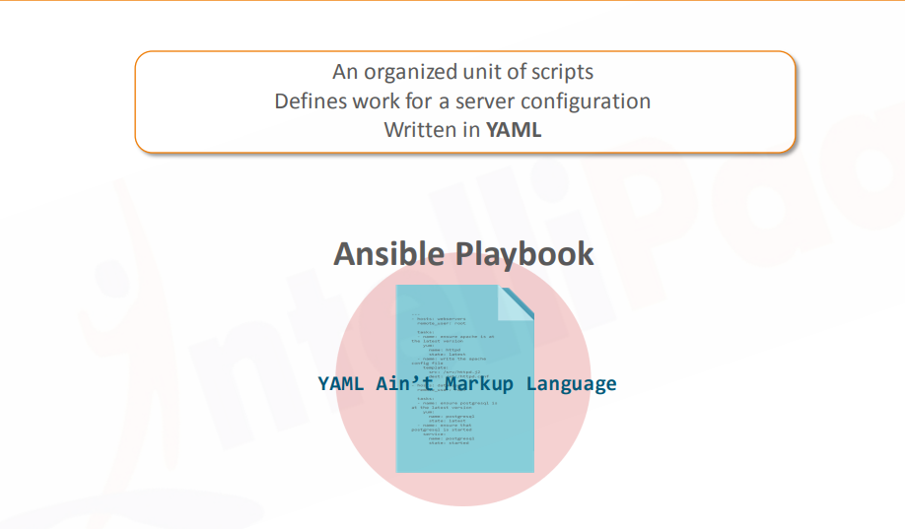
What is Ansible Playbook?

Slide 42
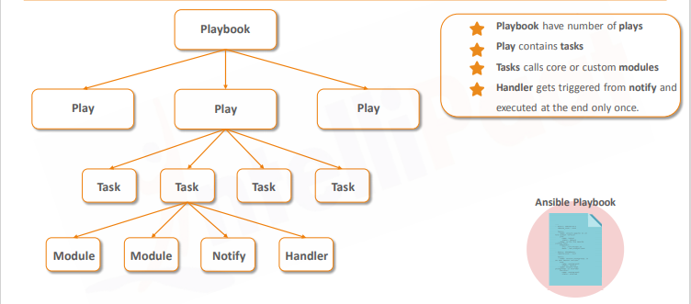
Ansible Playbook Structure

Slide 43
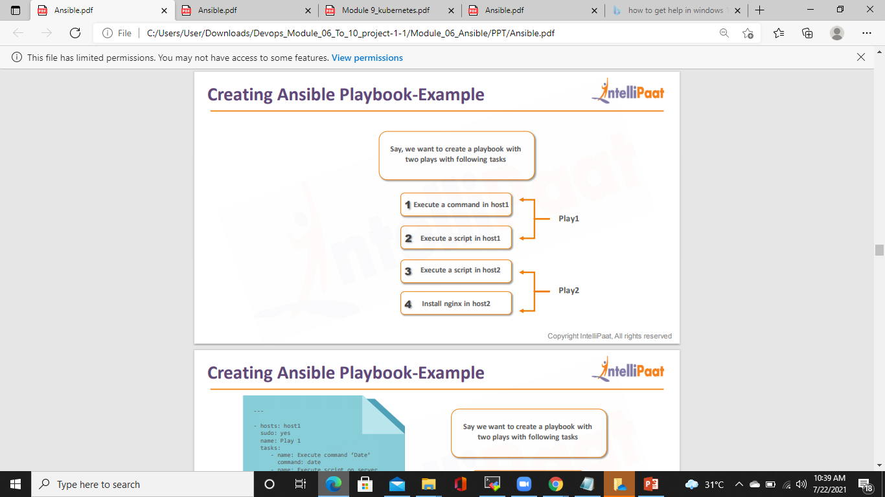
Creating Ansible Playbook-Example

Slide 44
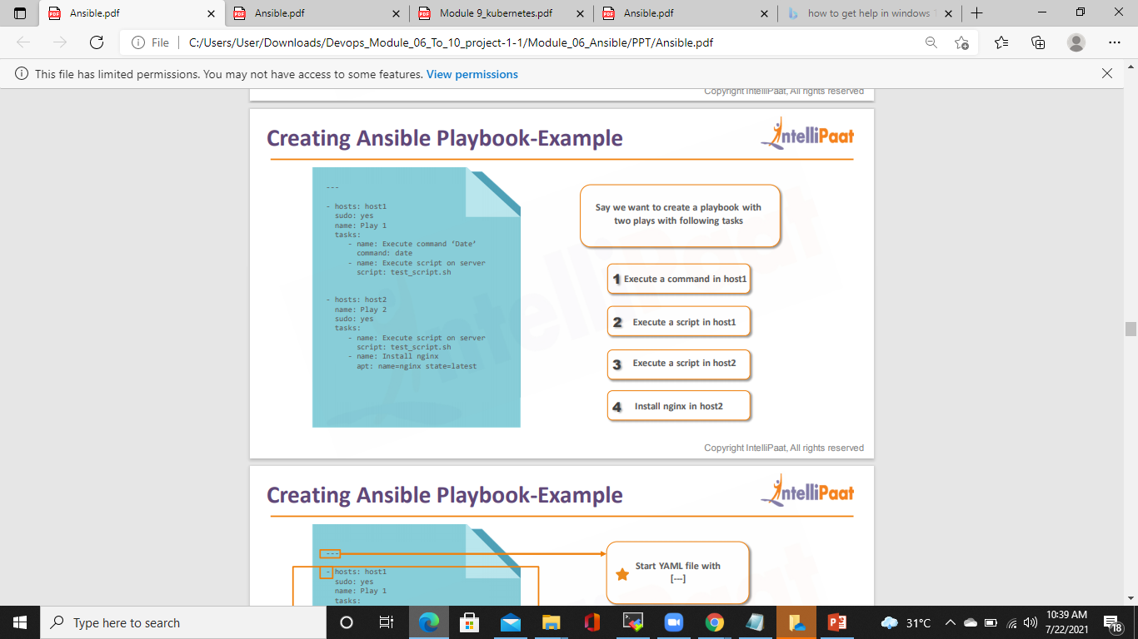
Creating Ansible Playbook-Example

Slide 45
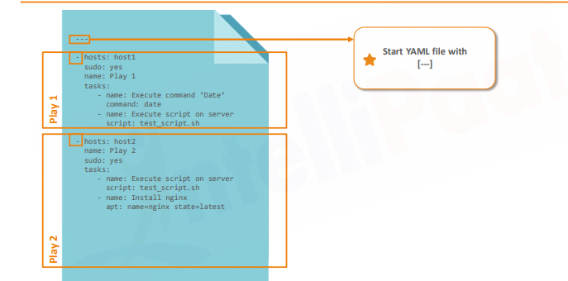
Creating Ansible Playbook-Example

Slide 46

Creating Ansible Playbook-Example

Slide 47
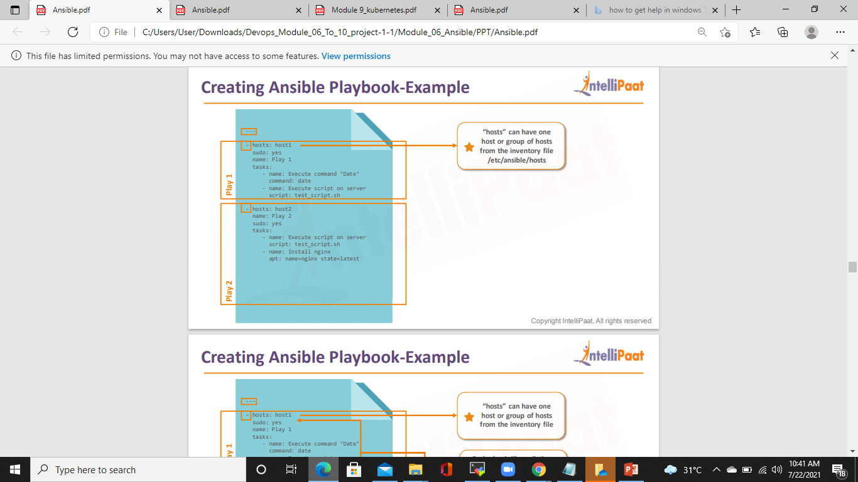
Creating Ansible Playbook-Example

Slide 48
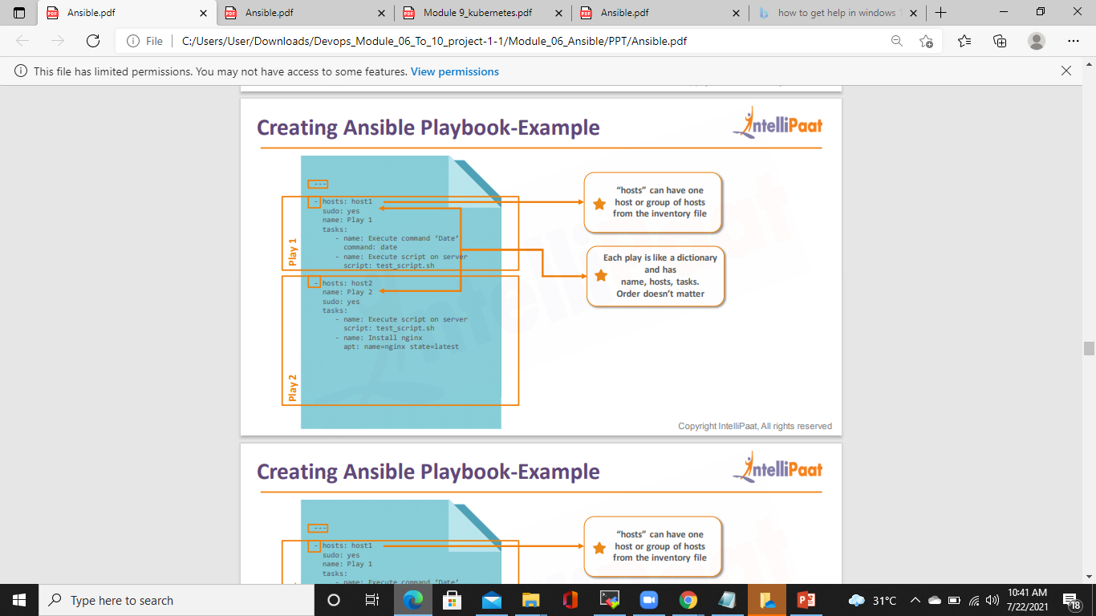
Creating Ansible Playbook-Example

Slide 49
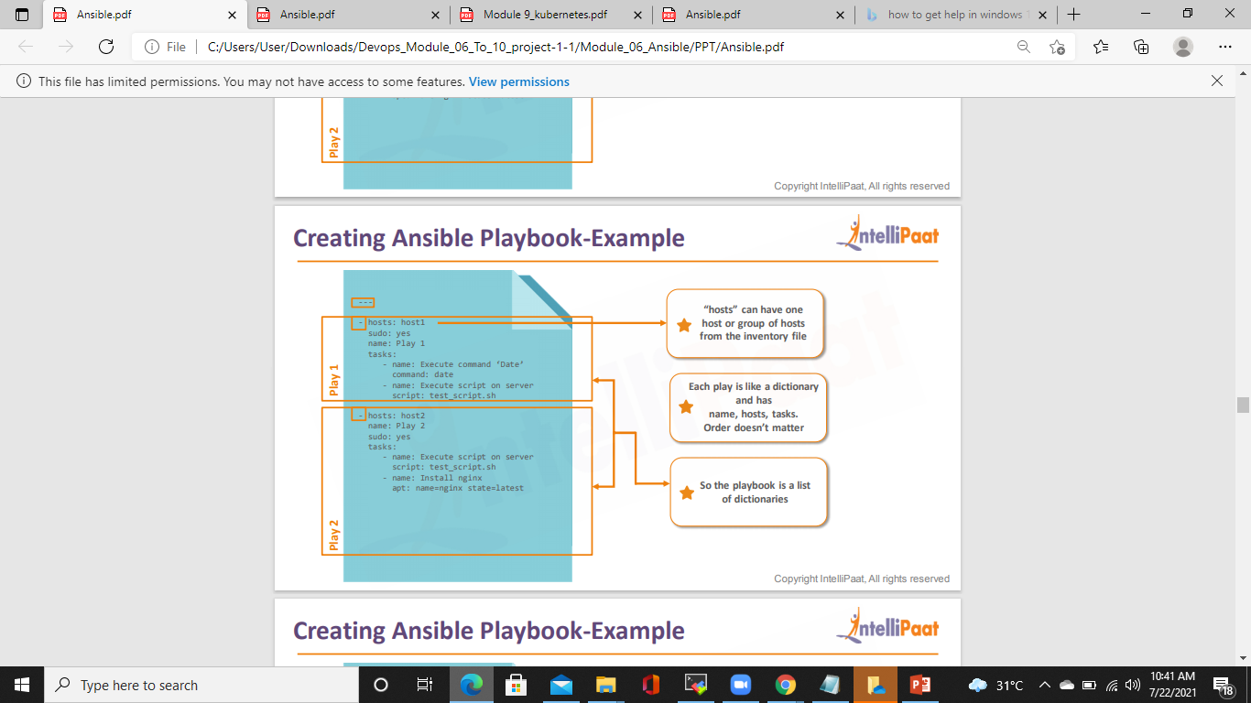
Creating Ansible Playbook-Example

Slide 50
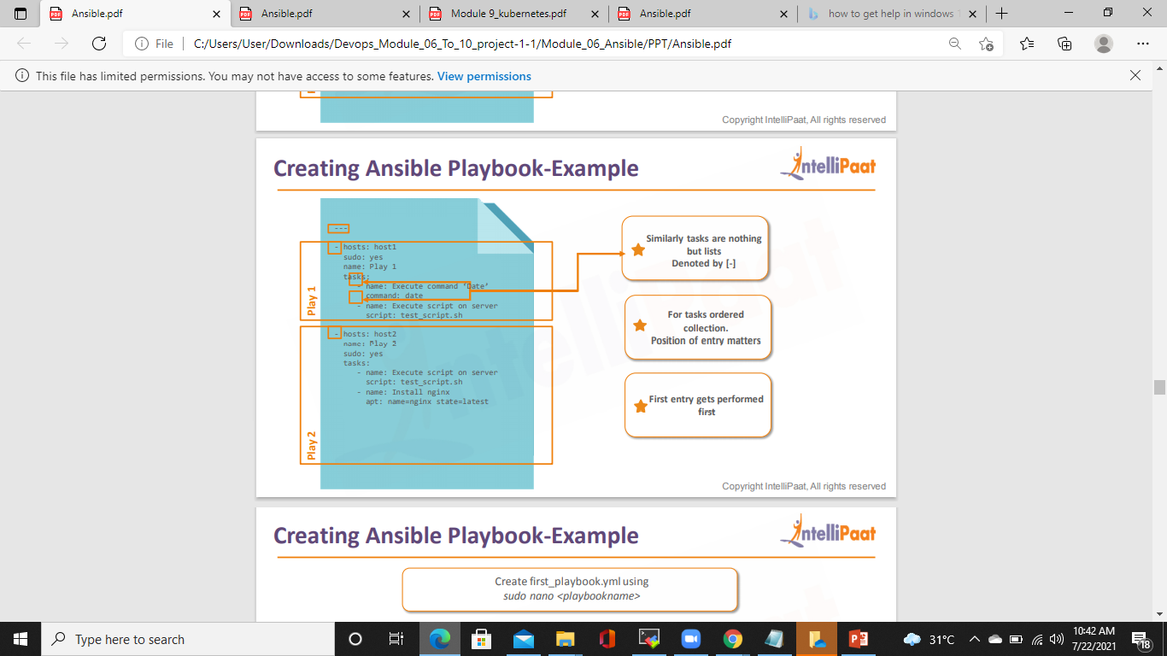
Creating Ansible Playbook-Example

Slide 51
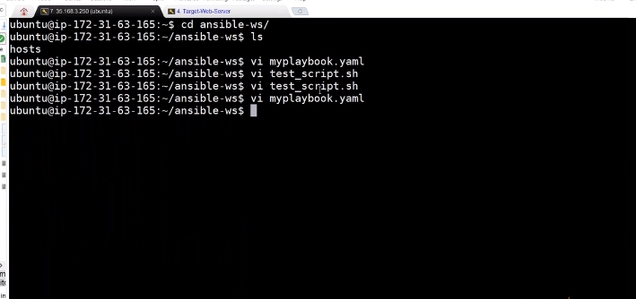
Playbook Creation

Slide 52

Playbook Creation

Slide 53
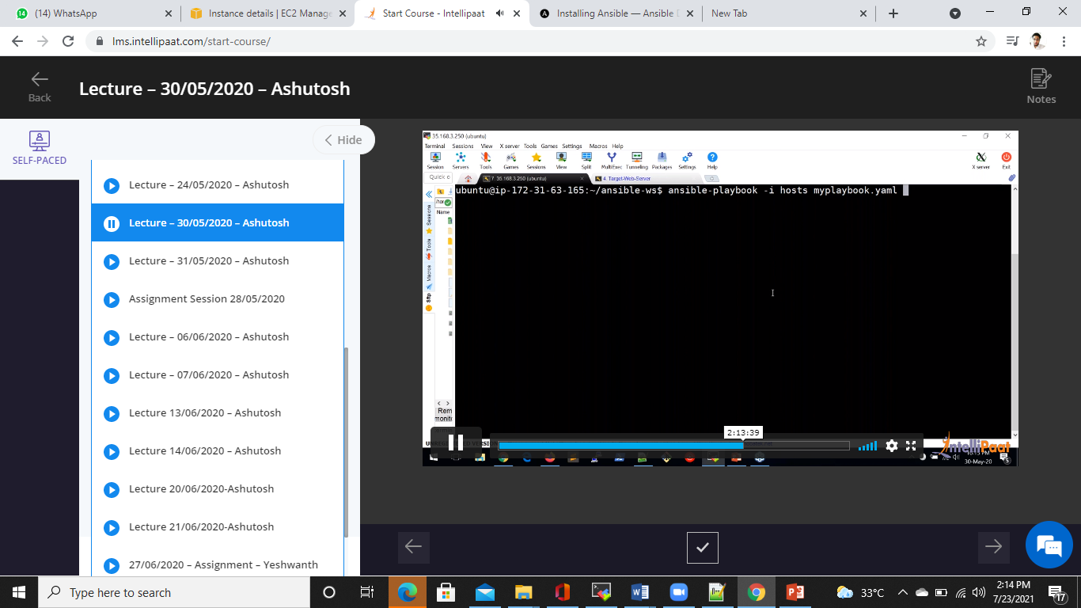
Playbook Creation

Slide 54
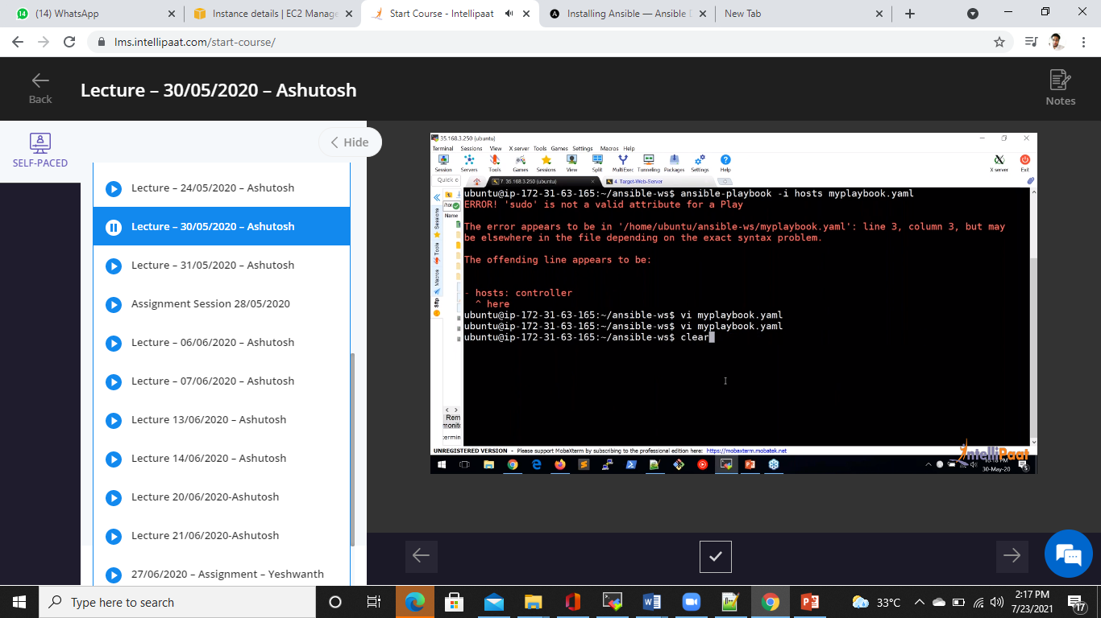
Playbook Creation

Slide 55

Playbook Creation

Slide 56
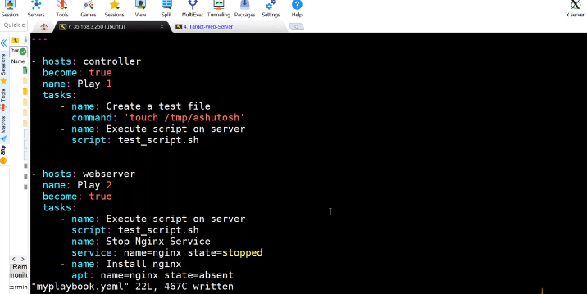
Playbook Creation

Slide 57
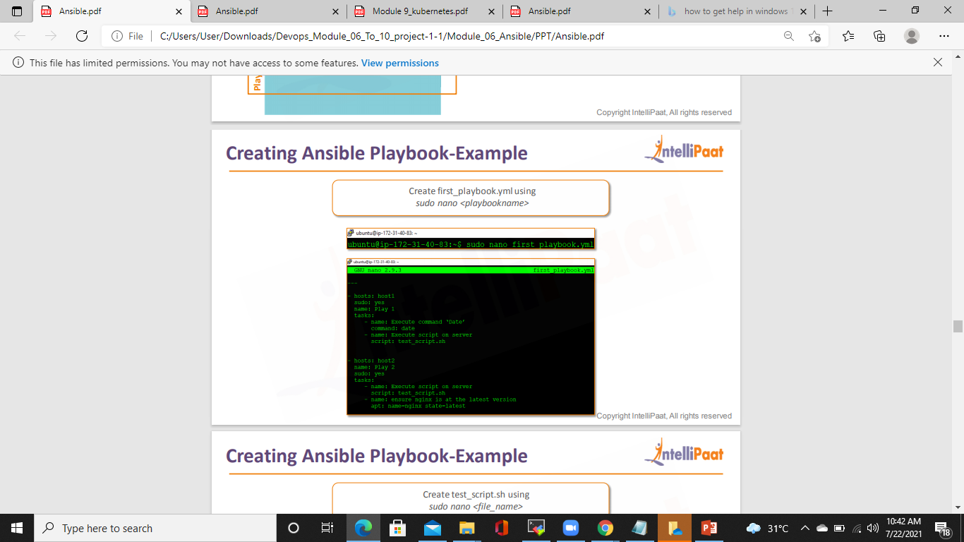
Creating Ansible Playbook-Example

Slide 58
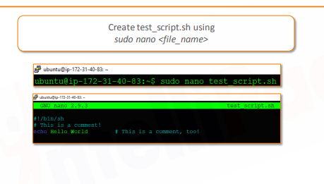
Creating Ansible Playbook-Example

Slide 59

Creating Ansible Playbook-Example

Slide 60

Ansible Roles

Slide 61

Why do we need Ansible Roles?

Slide 62

Structure of Ansible Role

Slide 63

Structure of Ansible Role

